Slide 1

Utilizing procedural generation to create a dungeon crawler game
Jack Travis
Supervisors: ---
Computer Science

Slide 2

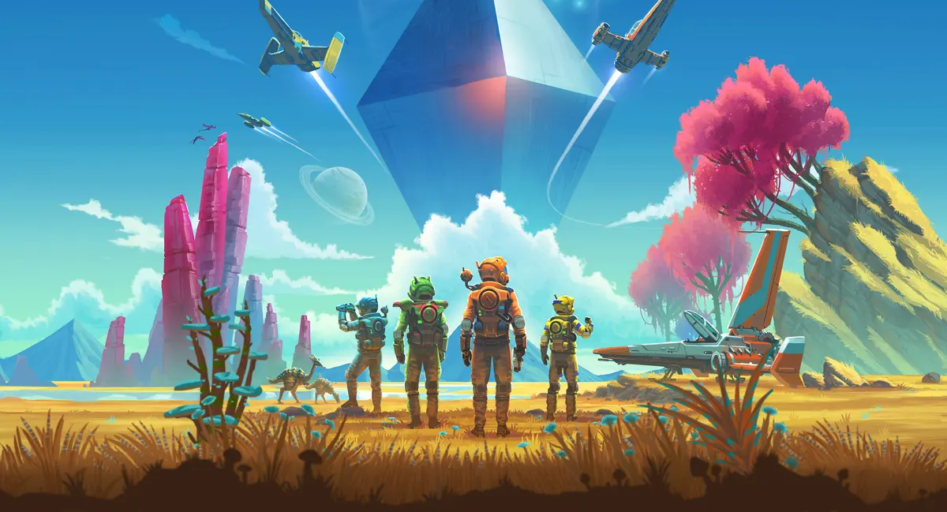
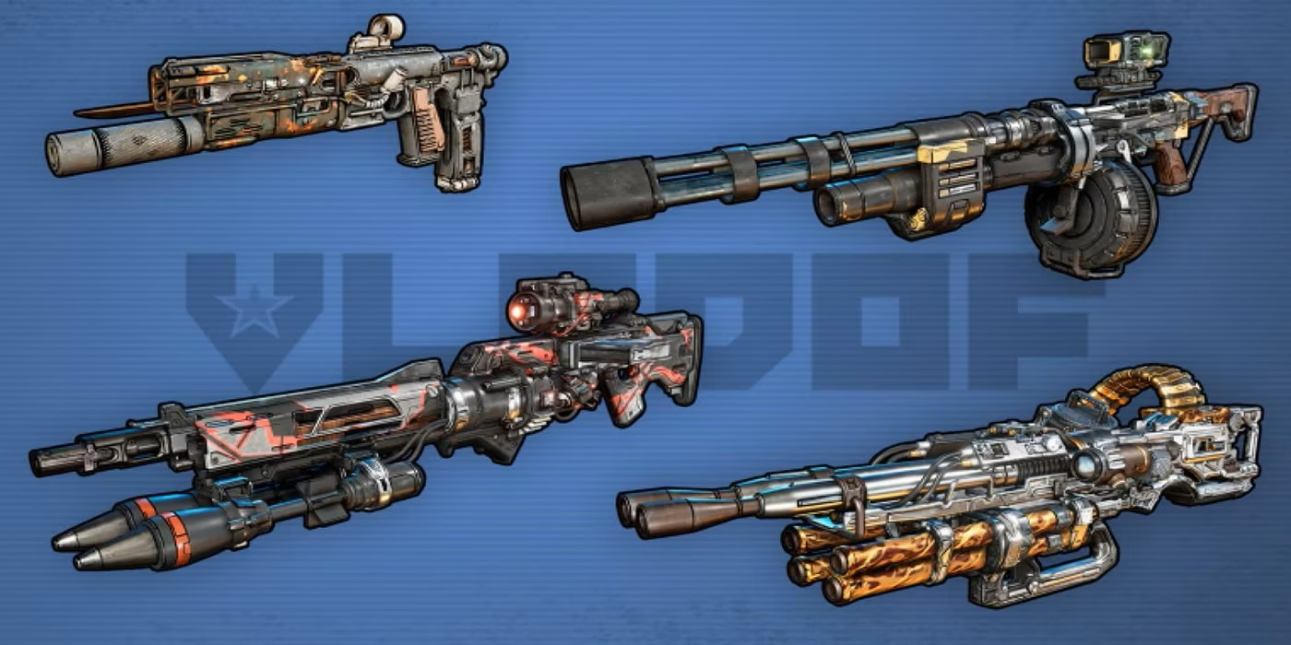
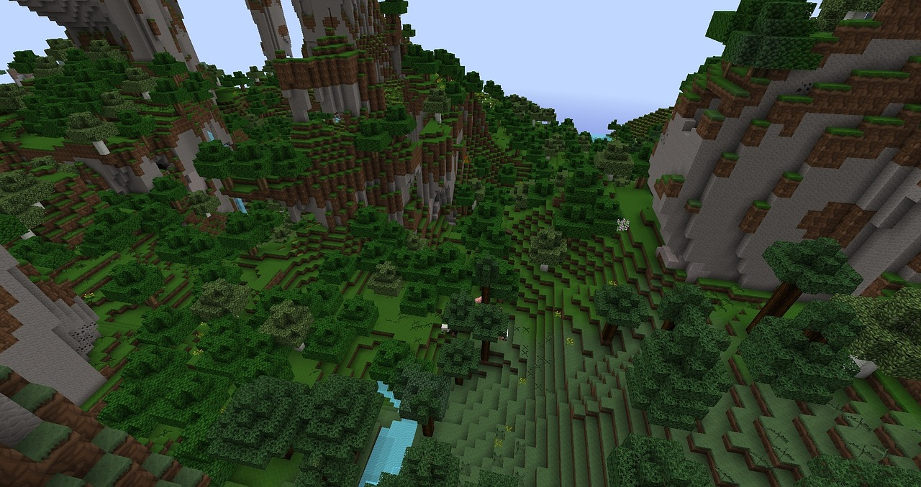
background
Procedural Generation is the automation of the generation process of game features.
Procedural Generation has seen many successful applications, such as Minecraft, Terraria, No Man’s Sky and the Borderlands series.
Using this method can allow for a greater variation in game, surpassing that what can be done manually. Such variation can make every playthrough/ encounter feel unique, increasing the players enjoyment and the games replay-ability.

Slide 3

Aims & objectives
To research the current state of procedural generation to provide a comparison between suggested solutions.
To pick and plan a suitable approach for my project.
To generate rooms, of customizable sizes, in valid positions, such as not overlapping with other rooms, with doorway(s) in suitable locations.
To generate a network of interconnecting corridors, connecting all generated doorways, to create a traversable map.
To distribute objects, such as light sources and chests, throughout the map to provide an example of how decorations/interactable objects could be procedurally placed.
To create and place AIs throughout the generated map, to show AI navigation is possible, for applications such as enemies.
To create a ‘How it Works’ option, whereby the user is visually shown the generation steps, to help aid with understanding how procedural generation works.
To create a ‘Custom Map’ option, whereby the user can alter the changeable parameters that affect map generation, creating their own custom map.
To create a player controller, allowing for easy traversal and investigation of a generated map.
To evaluate and review how successful my project was in comparison to other proposed solutions, providing information such as strengths and challenges, what the next steps would be and what questions arise for future research.

Slide 4





Chosen tools
Unity V2021.3.5f1
ProBuilder
TextMeshPro
JetBrains Rider

Slide 5
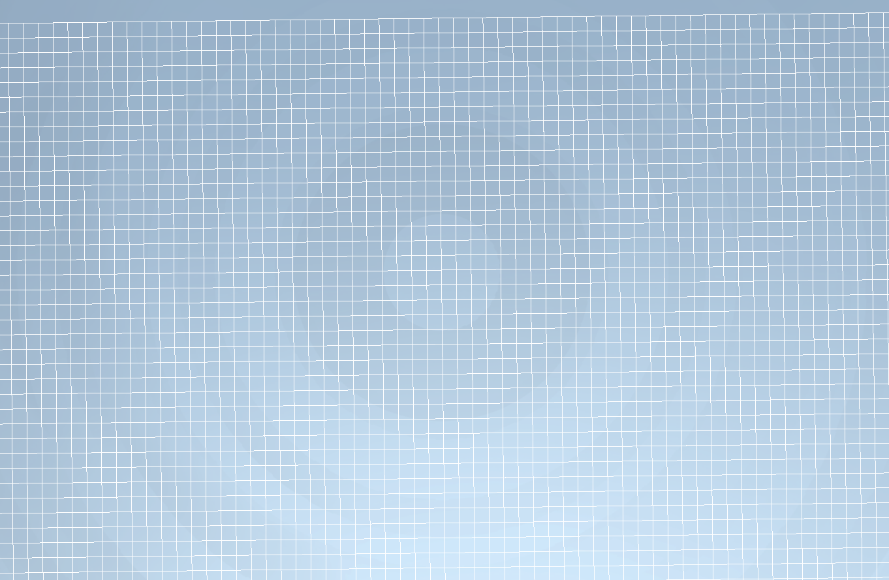
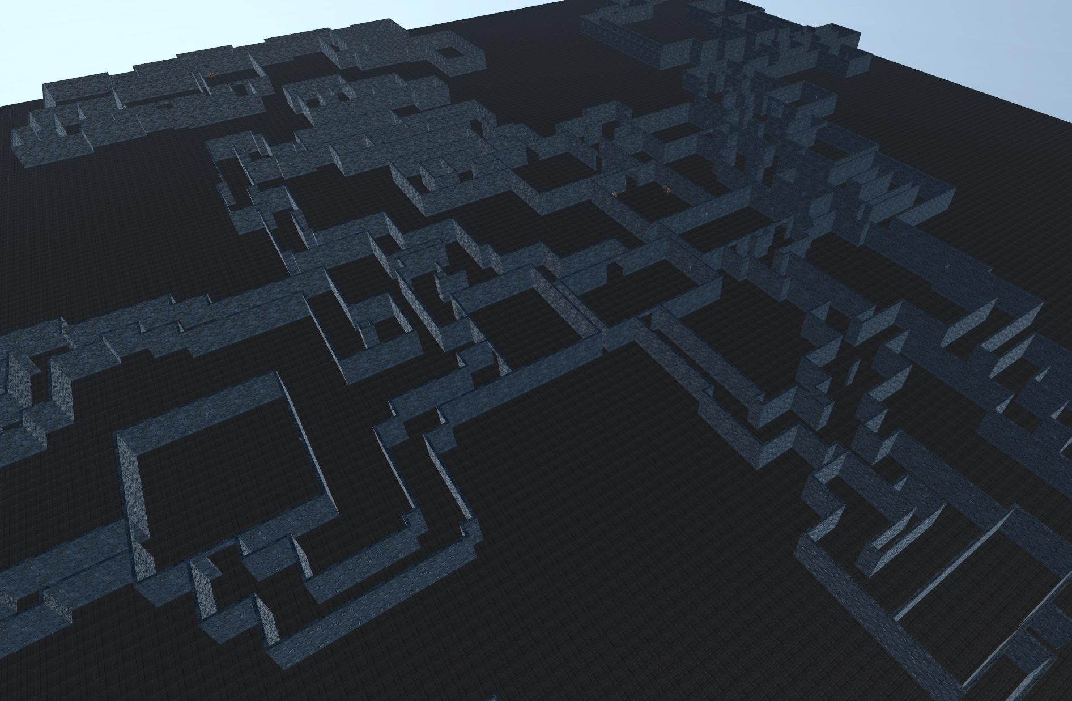
Design
The world is divided up into a grid. Each grid segment represents apart of the world, which may define the presence of a room or corridor, or state whether a wall should be placed in that position.
An array is used to hold the necessary information for each grid segment, which can later be interpreted to draw all the objects, such as walls and doorways, to create the map.
Space for rooms are first allocated, followed by doorway generation, then corridor generation. The array is then interpreted to generate the necessary objects, followed by room decoration.

Slide 6
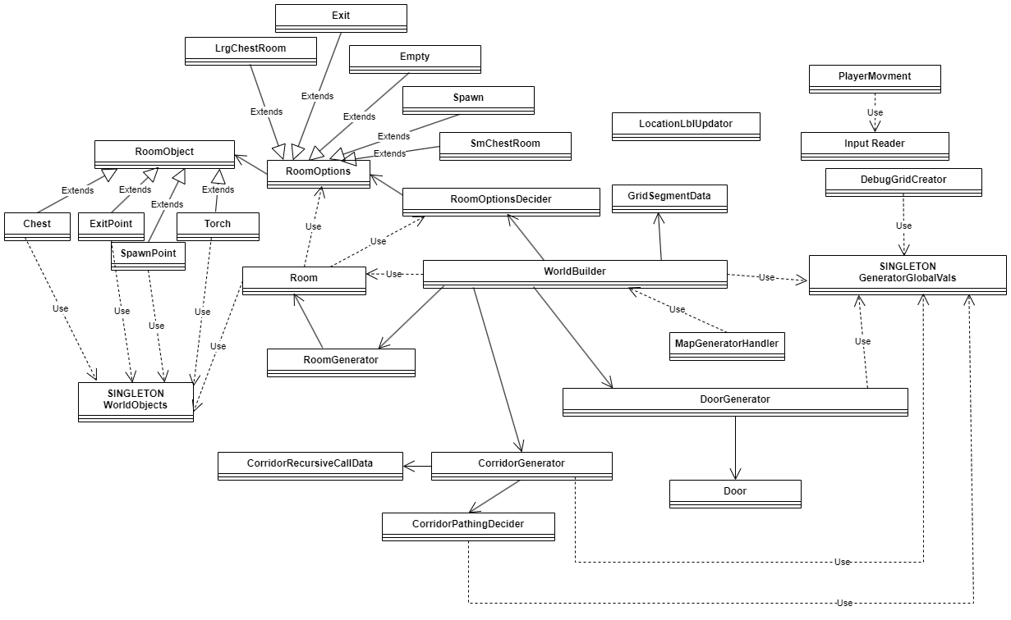
Design – Simplified UML Diagram

Slide 7
Testing and analysis
There were 3 methods to testing:
Automated testing: Run the program over many seeds to check for errors that interrupt execution.
Manual testing: Looking over the map manually to identify any logic issues causing issues with the generated map, but do not cause an error to be thrown.
User Testing: A survey was conducted on consenting participants.
The survey was also used to collect feedback on the generator, to identify areas of improvement.

Slide 8
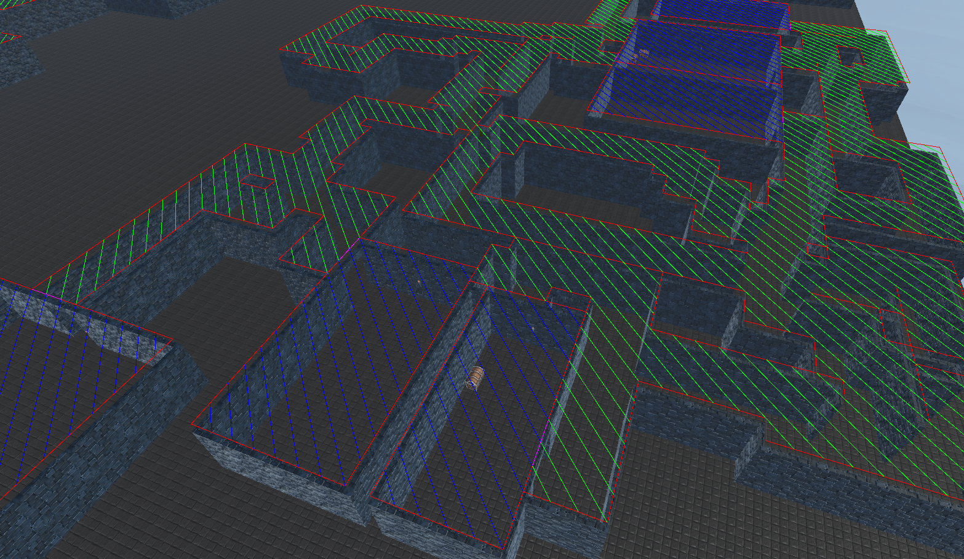
Manual Testing Aid – Debug grid
Coloured lines that provide a visual representation of the values of each grid segment.
It provided a great aid for manual bug finding and fixing.

Slide 9
major issues During development
Stretched Textures when using Cubes – Fixed by using ProBuilder
ProBuilder sometimes crashing after too many requests – Fixed by reusing created walls of the same size
Stack Overflow error caused by too high of a recursion depth when generating corridors – Fixed by manually implementing the stack
Cannot bake the map at run-time to allow NavMesh agents to control AI’s – No solution implemented

Slide 10



Conclusions & Future Work
8/10 objectives completed
Fast generation times – Suitable for runtime applications
The concept was proven to be successful
Customisable Map
No AI’s
Corridor generation is less sophisticated than initially intended
Hard to maintain & make changes
Implement an AI
Improve the room decorator & room variety
Implement a more sophisticated corridor generator
Generate multiple floors

